Slide 1
Strong Slot-and-Filler Structures
Chapter 10

Slide 2
Conceptual Dependency
Conceptual Dependency (CD) is a theory of how to represent a kind of knowledge about events that is usually contained in natural language sentence.
The goal is represent knowledge in a way that:
  Facilitates drawing references from the sentence.
  Is independent of the language in which the sentences were originally stated.
Capable of read and understand natural language text.
Unlike Semantic Nets, which provide only a structure into which nodes representing information at any level can be placed, conceptual dependency provides both a structure and a specific set of primitives, at a particular level of granularity, out of which representations of particular pieces of information can be constructed.

Slide 3
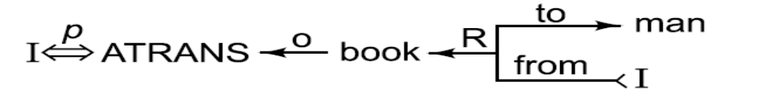
A Simple Conceptual Dependency Representation
“I gave the man a book.”
where the symbols have the following meanings:
Arrows indicate direction of dependency.
Double arrow indicates two way link between actor and action.
p indicates past tense.
ATRANS is one of the primitive acts used by the theory. It indicates transfer of possession.
o indicates the object case relation.
R indicates the recipient case relation.
236

Slide 4
CD Primitive Actions
ATRANS Transfer of an abstract relationship (e.g., give)
PTRANS Transfer of the physical location of an object (e.g., go)
PROPEL Application of physical force to an object (e.g., push)
MOVE Movement of a body part by its owner (e.g., kick)
GRASP Grasping of an object by an actor (e.g., clutch)
INGEST Ingestion of an object by an animal (e.g., eat)
EXPEL Expulsion of something from the body of an animal (e.g., cry)
MTRANS Transfer of mental information (e.g., tell)
MBUILD Building new information out of old (e.g., decide)
SPEAK Production of sounds (e.g., say)
ATTEND Focusing of a sense organ toward a. stimulus (e.g., listen)
237

Slide 5
CD Primitive Conceptual Categories
ACTs Actions
PPs Objects (picture producers)
AAs Modifiers of actions (action aiders)
PAs Modifiers of PPs (picture aiders)
238

Slide 6
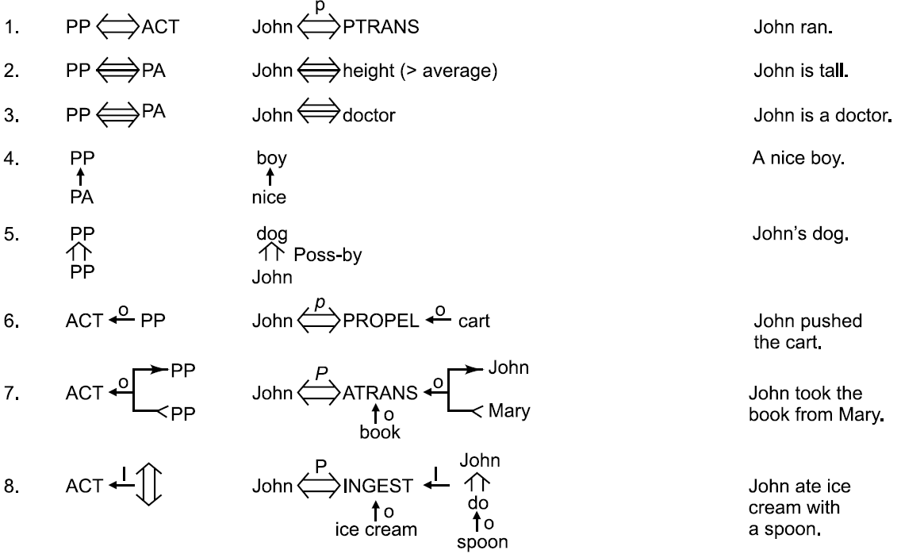
The Dependencies of CD
239

Slide 7
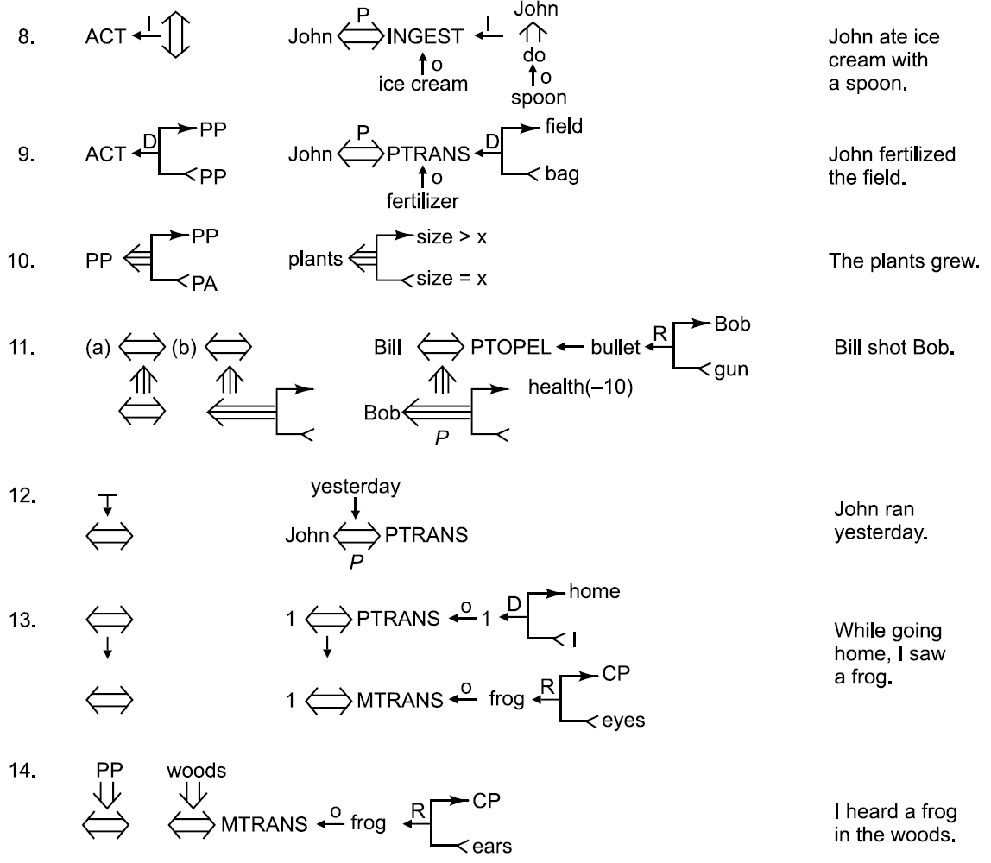
The Dependencies of CD (Cont’d)

Slide 8
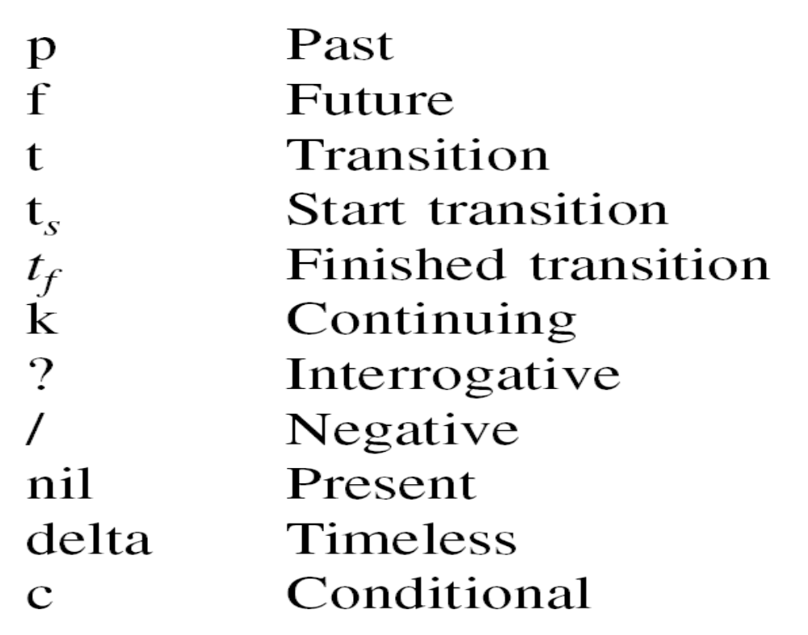
CD Conceptual Tenses
240

Slide 9
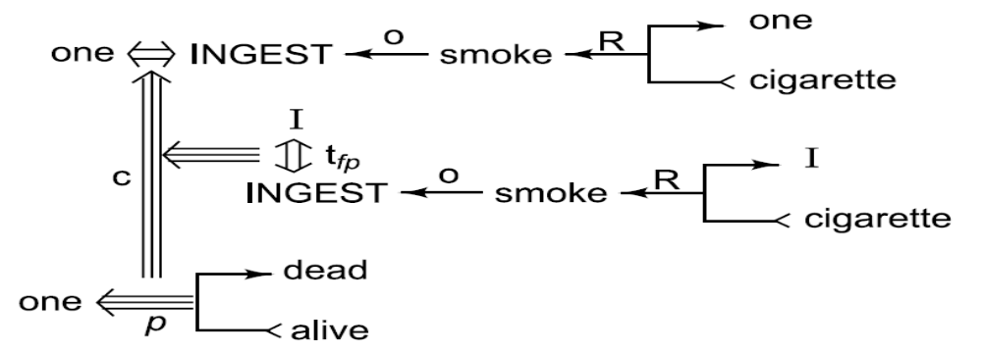
Using Conceptual Tenses
“Since smoking can kill you, I stopped.”
241

Slide 10
The Components of a Script
Entry conditions: Conditions that must, in general, be satisfied before the events described in the script can occur.
Result Conditions: that will, in general, be true after the events described in the script have occurred.
Props: Slots representing objects that are involved in the events described in the script. The presence of these objects can be inferred even if they are not mentioned explicitly.
Roles: Slots representing people who are involved in the events described in the script. The presence of these people, too, can be inferred even if they are not mentioned explicitly. If specific individuals are mentioned, they can be inserted into the appropriate slots.
Track: The specific variation on a more general pattern that is represented by this particular script. Different tracks of the same script will share many but not all components.
Scenes: The actual sequences of events that occur. The events are represented in conceptual dependency formalism.
243

Slide 11
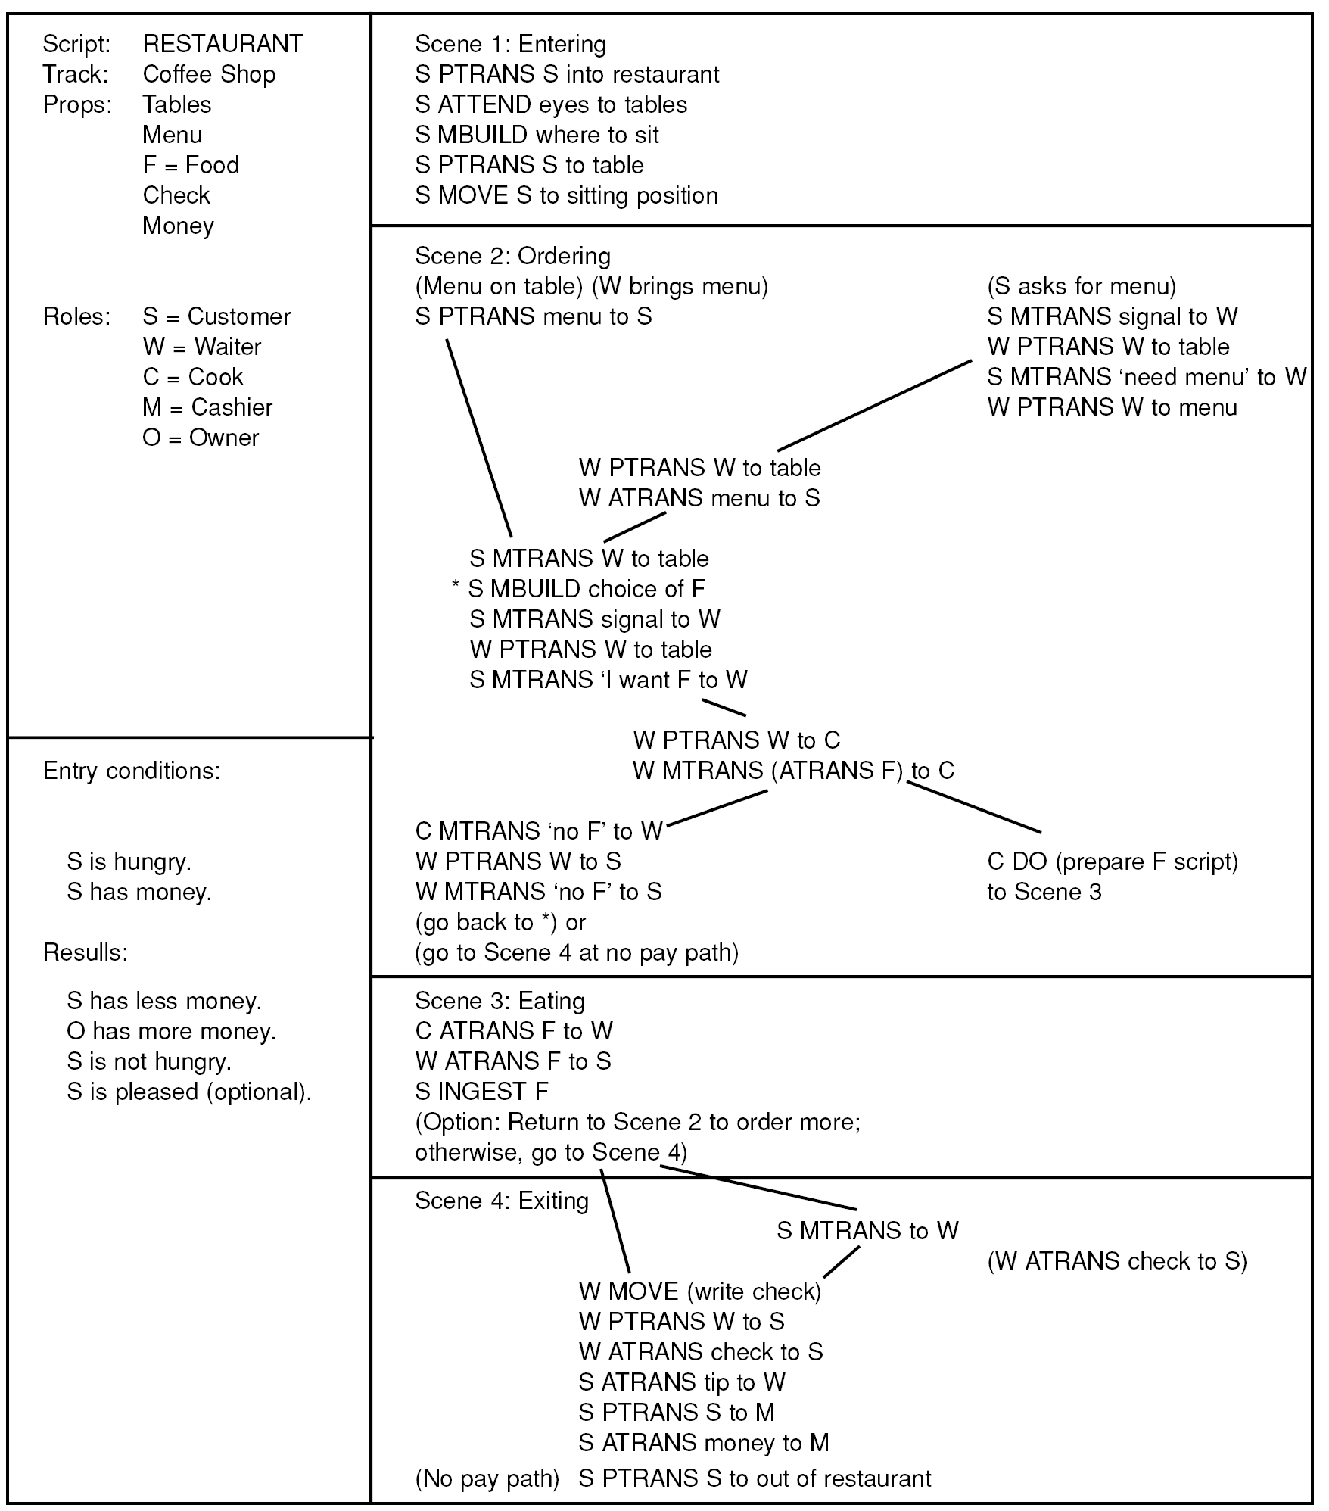
The Restaurant Script
244

Slide 12


